Slide 1
Fitch-Sequent Proof Converter
Chris Lipscomb and Max Wang

Slide 2
Agenda
Overview
Converting Proofs
File System
Class Structure
Demo
Questions

Slide 3
ProofConverter Software
Java Application
Parse files
Convert from Fitch to Sequent
Convert from Sequent to Fitch
Help command
https://github.com/Risch1997/ProofConverter

Slide 4
Converting Proofs
Fitch
1. ¬(P ∨ Q) ASSUMPTION
2. | P ASSUMPTION
3. | P ∨ Q DISJUNCTION_INTRODUCTION 2
4. | ⊥ CONTRADICTION_INDRODUCTION 1 3
5. ¬P NEGATION_INTRODUCTION 2-4
6. | Q ASSUMPTION
7. | P ∨ Q DISJUNCTION_INTRODUCTION 6
8. | ⊥ CONTRADICTION_INDRODUCTION 1 7
9. ¬Q NEGATION_INTRODUCTION 6-8
10. (¬P) ∧ (¬Q) CONJUNCTION_INTRODUCTION 5 9
Sequent
1. { ¬(P ∨ Q) } ⊨ ¬(P ∨ Q) ASSUMPTION
2. { P } ⊨ P ASSUMPTION
3. { Q } ⊨ Q ASSUMPTION
4. { P } ⊨ P ∨ Q DISJUNCTION_INTRODUCTION 2
5. { ¬(P ∨ Q), P } ⊨ ⊥ CONTRADICTION_INDRODUCTION 1 4
6. { ¬(P ∨ Q) } ⊨ ¬P NEGATION_INTRODUCTION 5
7. { Q } ⊨ P ∨ Q DISJUNCTION_INTRODUCTION 3
8. { ¬(P ∨ Q), Q } ⊨ ⊥ CONTRADICTION_INDRODUCTION 1 7
9. { ¬(P ∨ Q) } ⊨ ¬Q NEGATION_INTRODUCTION 8
10. { ¬(P ∨ Q) } ⊨ (¬P) ∧ (¬Q) CONJUNCTION_INTRODUCTION 6 9

Slide 5
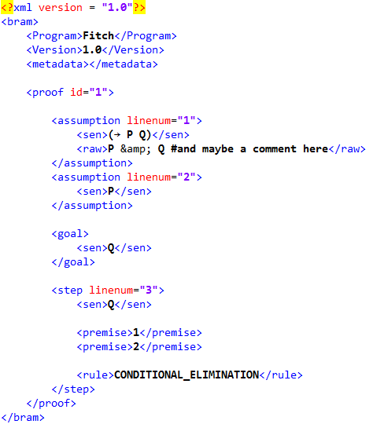
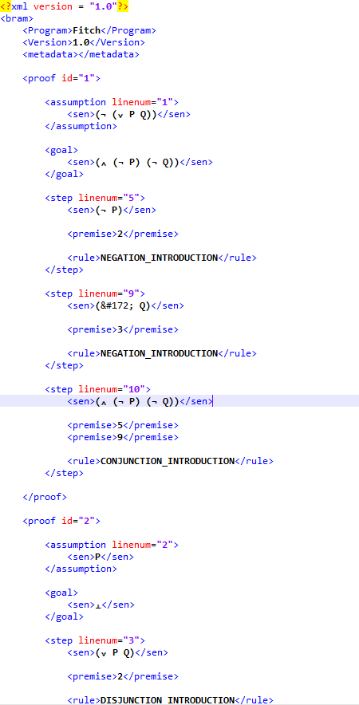
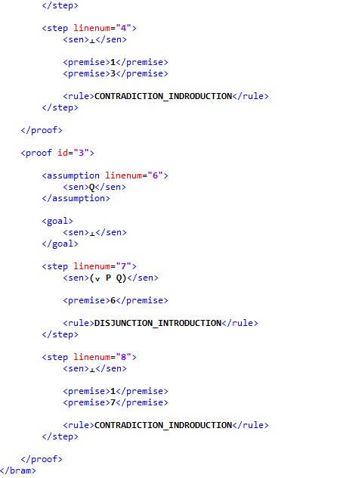
The .bram File - Fitch

Slide 6
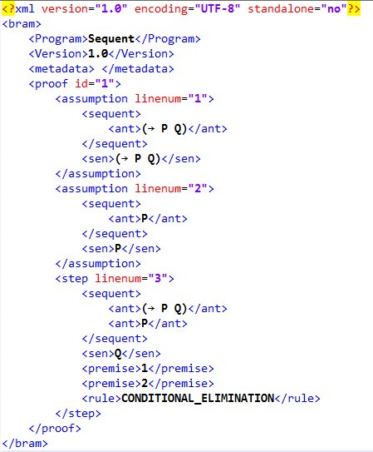
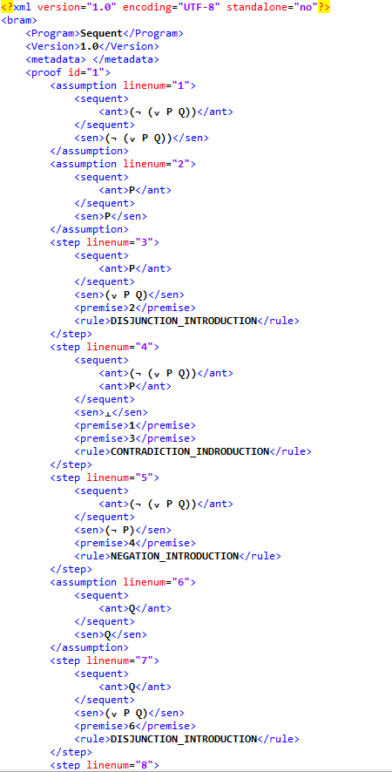
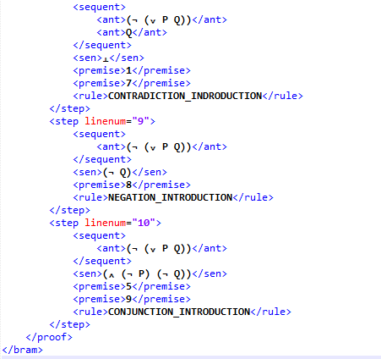
The .bram File - Sequent

Slide 7
Class Structure
Sentence
Operator
List<Sentence>
Single Sentence
Type
Step
Line Number
Sentence
Premises
Rule
Indent
SequentStep
Sequents
Proof
ID
Goal
List<Step>
Type
Start Line Number
End Line Number

Slide 8
Demo

Slide 9
Thanks! Do you have any questions?

